Slide 1
Department of Information Technology
A.P. Shah Institute of Technology G.B.Road,Kasarvadavli, Thane(W), Mumbai-400615
UNIVERSITY OF MUMBAI
Academic Year 2019-2020

Slide 2
A Project Report on
Title of your project
Submitted in partial fulfillment of the degree of Bachelor of Engineering(Sem-8)
in
INFORMATION TECHNOLOGY
By
Nirmit Dagli(16104013) Sarvesh Sawant(17204013) Mihir Deorukhkar(16104065)
Under the Guidance of Prof. Kaushiki Upadhayaya Prof.Nahid Shaikh

Slide 3
1.Project Conception and Initiation

Slide 4
1.1 Abstract
Consider a college education portal needs to provide diﬀerent courses and tutorials to its students. But to
incorporate numerous resources and tutorials onto one education portal can be tedious and space constraint.
Having multiple systems typically require multiple sign-on dialogues to access the resources. Users need to register on multiple portals to access the contents and courses and it involves the headache of remembering multiple sets of credentials.
Users also have to present credentials multiple times they login to these portals/websites. With these
scenarios, more the portals, the more sign-ins are required. It also requires to restrict access to unauthorized users when log-ins are authenticated.
If there are redundancy of resources and inconsistent information across multiple website across the systems, users may show lack of interest. Single sign on system is the proposed method to provide access to the educational learning resources/contents.
In this approach only one set of credential is required, user can access the multiple services with those same credentials once integrated into all systems. This approach provides a secure way to authenticate users and give access to all services.

Slide 5
1.2 Objectives
To provide a service for accessing multiple platform using single credential
By using LDAP , a single central database will maintain information of multiple
accounts at the same time.
Making Authorization process more Secure.
Reducing the database chunk with one central database.

Slide 6
1.3 Literature Review
Sr. No | Title/Author | Method used
1. | Pranav B. Sahare, Design and implementation of single sign-on system for educational systems. | Implementing SSO using API.
2. | Anjali Nair,Arun Madhu & Jubilant J “Security Issues of Single Sign on Web Services”,2015 | Identification of flaws and risks associated with SSO service
3. | Jian Hu,Qizhi Sun & Hongping Chen, “Application of Single Sign On In Digital Campus”,2010 | Implementinng SSO using LDAP protocol

Slide 7
1.4 Problem Definition
In our college we have multiple services like Payment Portal, HandBook, Webstore, IT Server, Internet Password,etc. To access them students need to remember various ID’s and Password. To maintain this services different databases are used.
To solve this problem we can use LDAP, in which student/staff will require just a
single password to access multiple services.

Slide 8
1.5 Scope
Since a single user may require multiple credentials to login, our system provides a SSO service that reduces the burden of remembering multiple id and password.It eliminates the job of getting authorized on each website we enter.
Every organization has multiple services which has their own different id’s and
passwords which brings inconvenience to the user, so single sign-on is a solution to
this problem.

Slide 9
1.6 Technology stack
LDAP SERVER
Apache Directory Studio
Glassfish Server
JAVA
NetBeans
WEBSITE
HTML,CSS
ANDROID APPLICATION
Android Studio
Nox Emulator

Slide 10
1.7 Benefits for environment & Society
By increasing the users of the distributed systems that should often access to remote resource, diﬀerent authentication techniques are needed when users want to enter the systems. Therefore, SSO technology has been introduced as a special form of authentication mechanisms.
This technology is meant to facilitate the job for users in a way that with one
credentials they could be able to access to several software resources on diﬀerent servers.

Slide 11
2. Project Design

Slide 12
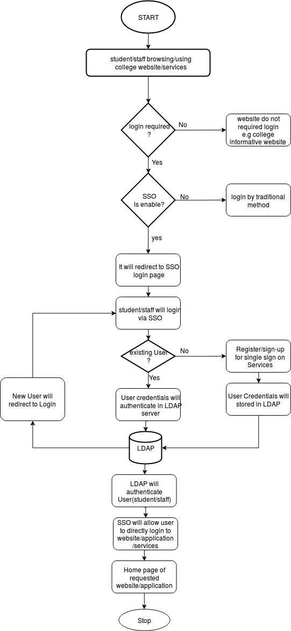
2.1 Proposed System

Slide 13
2.2 Design(Flow Of Modules)
User needs to register.
User details will be stored in LDAP Server.
User can access any website which have embedded SSO portal to login page.
User details will be retrieve from LDAP Server.
Authentication and Verification from LDAP server.
Admin can also create user and maintain the user.
Once the user will login he will be able to access the websites which are integrated with the LDAP Server.

Slide 14
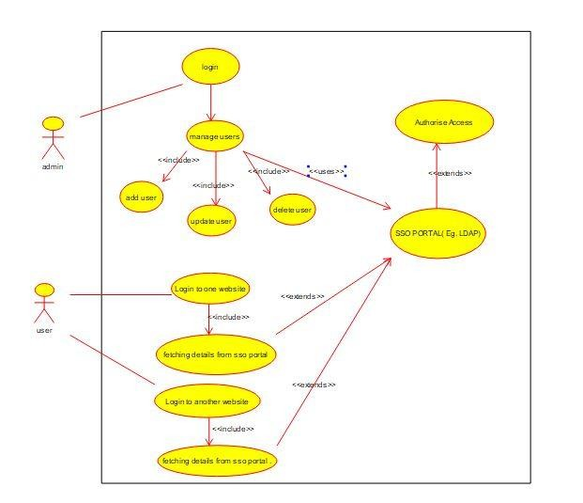
2.3 Description Of Use Case
Our use case consists of two major entities that interact with the major modules of the system.
The first one is the user who can sign up/login, login to multiple Website.
The second is the administrator who has an access to access the backend database enter and manage records, handle authentication process. Also maintain various CRUD operation.

Slide 15
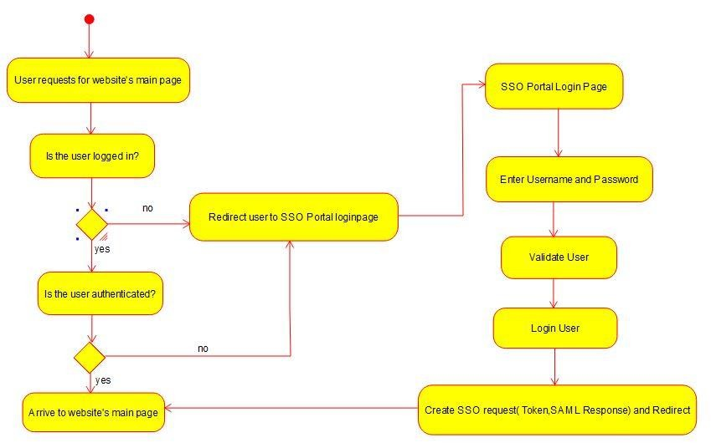
2.4 Activity diagram
Activity diagram begins with users request for a webpage.
If the user is logged in then the user will be authenticated.
If the user is not logged in the user will be redirected to the SSO login Portal.
The user need to enter the SSO credentials. Then the user will be validated and a token will be generated.
This token will be sent to the request website and the user will be able to access the requested website.

Slide 16
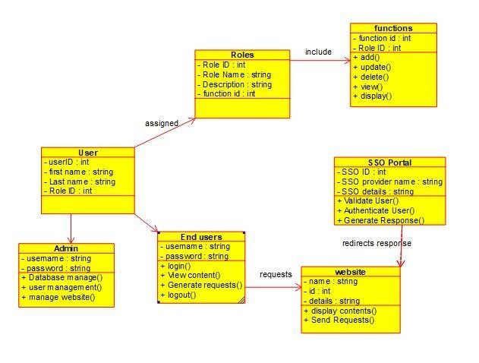
2.5 Class Diagram
The class diagram alongside displays various modules of our system interacting with each other.
System is divided into two users admin and end user.
All users are classified into different roles and each role is associated with different function.
End user requests for the website and this request is sent to the SSO portal. The SSO portal validates the user and redirect the response to the website.

Slide 17
2.6 Module-1
Login/Register
New user need to register to Single Sign On Portal.
Existing users just need to login to access the websites associated with LDAP.
Once the user successfully login to the Single sign on webpage the user will be able login to any of the websites without re-entering the username and password.

Slide 18
Module-2
Authentication
When the user tries to login to the LDAP server, the LDAP server will authenticate the user.
All the user’s credentials will be saved in the LDAP server.
If a new user is created his entry will be stored in LDAP server.

Slide 19
Module-3
Single Sign On Portal
Once the user is authenticated he will be redirected to website as per the requirement of the user.
User will be able to use any college website once Logged by same user
credentials.
Single Sign On Portal will maintain the session for User.
SSO can be integrated in the android applications.

Slide 20
2.7 References
APPLICATION OF SINGLE SIGN-ON (SSO) IN DIGITAL CAMPUS Jian
Hu,Qizhi Sun, Hongping Chen
An Automated Enterprise IT Management System Based on LDAP
OAuth-SSO: AFramework to Secure the OAuthbased SSO Service for Packaged
Web Applications

Slide 21
3. Conclusion and Future scope

Slide 22
Conclusion
The Single Sign On System is developed with the aim of reducing the burden of the users of remembering different set of credentials for different websites, web application, mobile apps, etc and also reduces the burden of login to applications again and again that is if they login into one website they are automatically logged into all other website.
The basic features that could be included in the system during the time period were: 1. Sign-up & Test Website
2. API
3. LDAP server
4. Admin Access
5. Android Application

Slide 23
Future Scope
There can be profile picture of the user & tracking feature for the usage of the API.
There can be appropriate documentation for the API usage.
There should be option for Forget Password.
Single Sign out(Security Purpose).

Slide 24
Thank You

